Slide 1

Anomaly Detection Practical – Challenge I
Hamza Tahir & Muhammad Hamza Usmani
Technische Universität München
Fakultät für Informatik
8 November 2016

Slide 2
Data
Blue Region
Red Region
Infrared Region 1
Infrared Region 2
92
86
93
93
90
93
70
75
84

Slide 3
Data Preprocessing
Feature Mean: The missing value of a particular feature is replaced by average value of of the feature. This averaging technique is generic to replace missing values for all kinds of datasets.
Feature Maximum: The missing value of a particular feature is replaced by the max value of the feature.
Nine-Neighborhood Mean: Missing values were replaced by
averages in a particular nine-neighborhood.
Immediate Neighborhood Mean: This approach is similar to the Nine-
Neighborhood one but here image locality is leveraged to better replace missing
values. The underlying assumption is that closely related pixels have similar val-
ues. Therefore, rather than using the entire 9 neighborhood, only 'immediate'
neighbors are used for the average value. 'Immediate' neighbors are dened as
the pixels that are to the left, right, top and bottom of the 9-neighborhood.

Slide 4
Data Preprocessing

Slide 5
Feature Weighting
Assumption: Not all features contribute equally to determine the class of a sample
different features can have different weights that represent their relative importance to the classication model.
In particular, we could not be certain that a certain spectral band was more or less important for the classication of cotton soil.
It might be the fact that the green spectrum was more important, or maybe the infra-red spectrum.

Slide 6
Feature Weighting
Assumption: Not all features contribute equally to determine the class of a sample
We used basic techniques based upon correlation to determine weights of the features.
First, we extracted each feature out individually and trained our classifiers on each separately.
The feature that had the lowest accuracy after 3-fold validation was then completely removed from the training of the model.
However, this did NOT prove to be a good replacement model..

Slide 7
Techniques Used
1. Naive Bayes
2. Support Vector Classier (SVC)
3. K-Nearest Neighbors (KNN)
4. Decision Trees
5. Neural Network - Multi Layer Perceptron
6. Random Forest
Used 3-fold cross validation for each to calculate the training error.

Slide 8
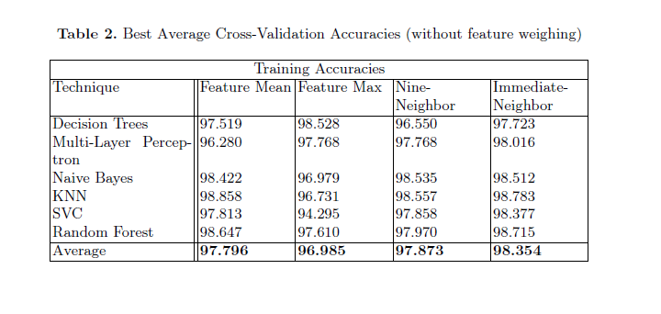
Results: Training Error with 3-Cross Validation

Slide 9
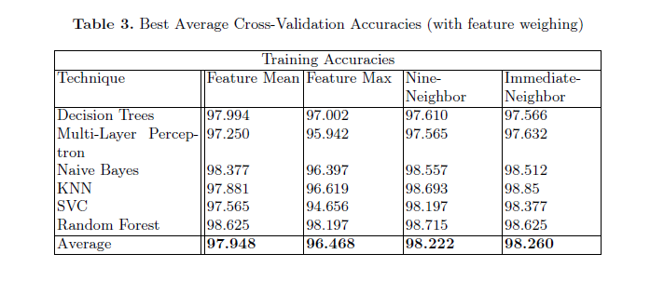
Results: Training Error with 3-Cross Validation

Slide 10
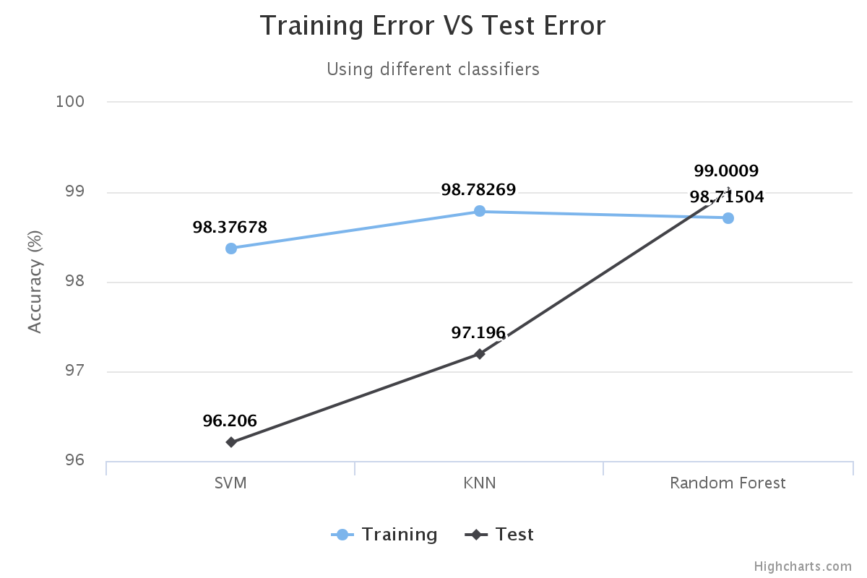

Slide 11
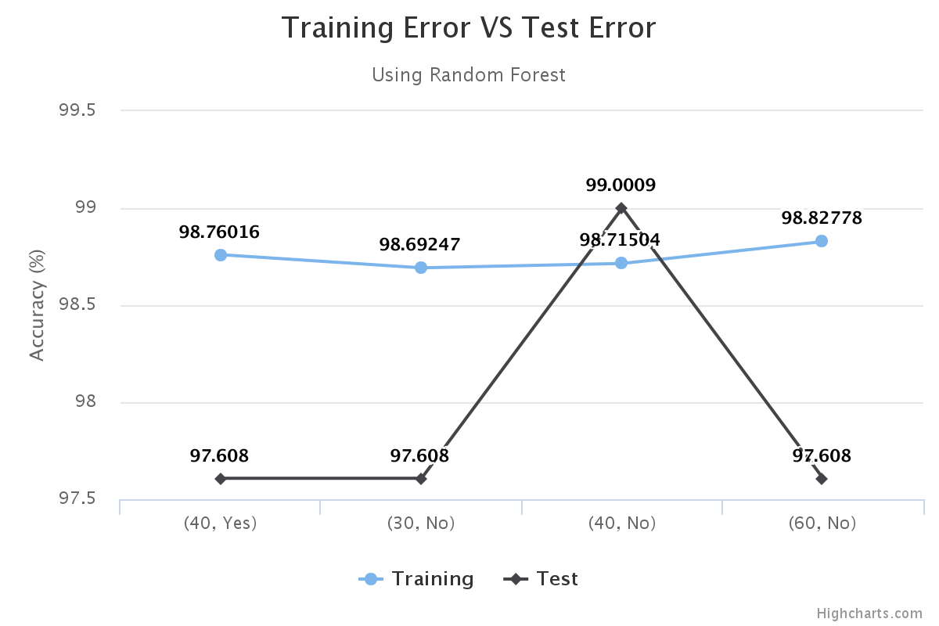

Slide 12
Thank you!

